Slide 1


Welcome to the Spektrix Patterns Group
Abstract Factory Pattern

Slide 2
Agenda
To discuss and improve our understanding of design patterns. Initially we'll follow the 23 week guide covering the Gang of Four Design Patterns laid out by Joshua Kerievsky here - https://www.industriallogic.com/papers/learning.html
Although we'll introduce the Pattern with a code example at the start of the meeting, this is not designed to be a training session, it's intended to be a Study group to consider various questions about the pattern. In doing so we'll benefit from the wisdom of the crowd and hopefully improve our understanding.
Deep knowledge of patterns isn't required, and a diverse range of perspectives is encouraged, but it would be useful preparation if you have studied the pattern that'll be discussed before each session.
1 hour approximately
Introduction to Abstract Factory Pattern
Split into groups to build an implementation of a Pizza store - 20 minutes
Refactor the Pizza Store to see how Abstract Factory Pattern can be used - 20 mins

Slide 3
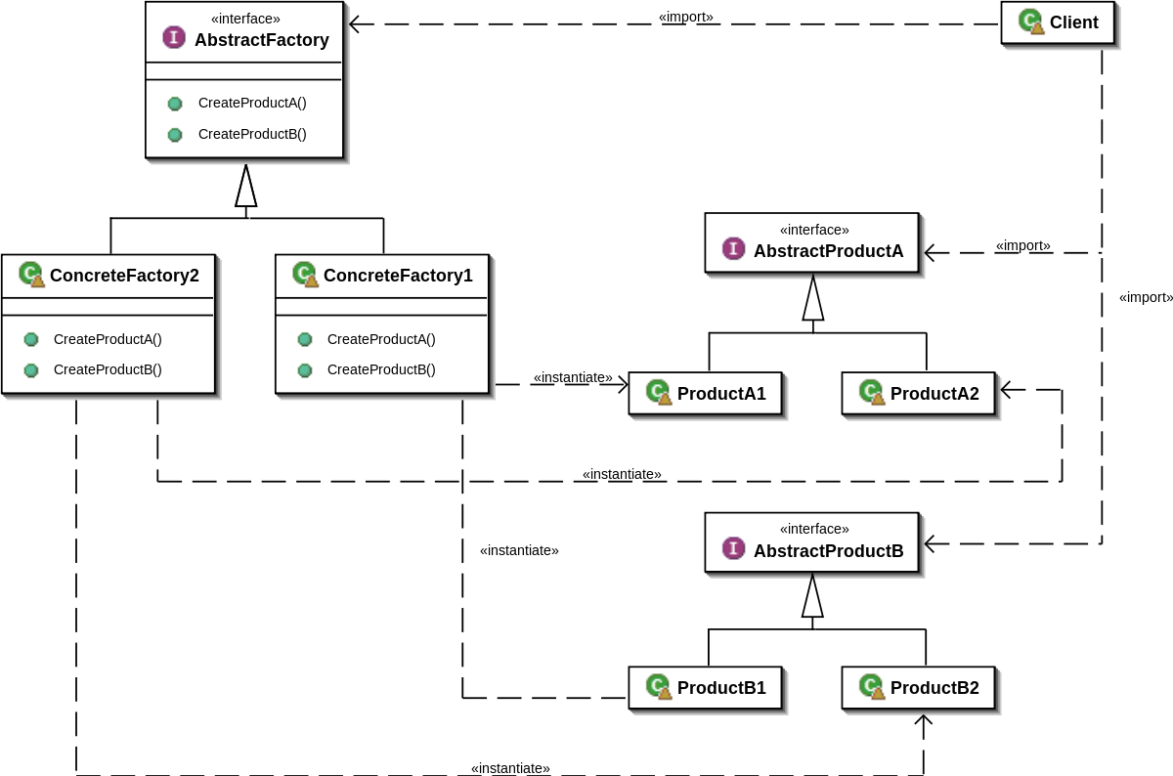
Abstract Factory Pattern
“Abstract Factory Pattern is a creational design pattern that Provides an interface for creating families of related or dependent objects without specifying their concrete classes.” The factory determines the actual concrete type of object to be created, and it is here that the object is actually created
Notes:
Other creational design patterns: Builder pattern
Abstract Factory
Singleton
Prototype

Slide 4
Baking Pizza
Our intrepid band of StarBuzz entrepreneurs have moved on from Coffee and discovered this hot new food - Pizza! Pizza is easy to make, you prepare a round base of fresh dough, add sauce and cheese, bake it in an oven, cut it into slices and deliver the Pizza in a cardboard box. How hard can it be? They have all the code ready, but customers keep coming up with weird variations! The people in New York want thin crusts but the customers in Chicago want it thick with a different sauce and more stringy cheese.
Don’t get me started on the toppings. Pineapple???
We need to make it easier to adapt this pizza store to cater to their needs.

Slide 5
Principles covered by this pattern
SOLID Principles:
Single responsibility principle
A class should have only a single responsibility, that is, only changes to one part of the software's specification should be able to affect the specification of the class.
Open–closed principle
"Software entities ... should be open for extension, but closed for modification."
Liskov substitution principle
"Objects in a program should be replaceable with instances of their subtypes without altering the correctness of that program." See also design by contract.
Interface segregation principle
"Many client-specific interfaces are better than one general-purpose interface."
Dependency inversion principle
One should "depend upon abstractions, [not] concretions."
Program to an implementation ( prefer things like var x = makeY() over var x = new y() )
Dependency Inversion Principle
Open Closed Principle
Notes:
Code to an interface(abstraction) not an implementation
Encapsulate what varies - Identify the aspects that vary and separate them from what stays the same. (If Maze, else Bombed Maze else Enchanted Maze) - not “closed for modification.” To extend it with new concrete types, you’ll have to reopen it.
The factory method encapsulates the domain knowledge of how to create the concrete class
Consider the number of dependencies that emerge as the system becomes more complex - (look at the UML)
What if you wanted to create families of products (which we do in the maze game - would a bombed maze have an enchanted wall?)
Dependency Inversion Principle - requires abstracts
It depends on every type of maze element because it actually instantiates concrete types.
No variable should hold a reference to a concrete class.
No class should derive from a concrete class.
No method should override an implemented method of any of its base classes.

Slide 6
Next Session
Let’s talk about… Builder
Spektrix.SetDiscussion(new DiscussionSession()
.NextSession()
.WithPattern(“Builder).Build())

